Slide 1

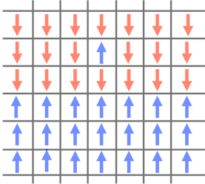
Monte-Carlo Simulation of 2D Ising Model
Adityaa Bajpai
Navya Gupta

Slide 2
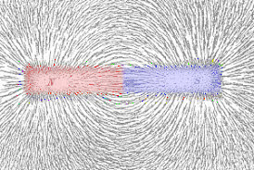
Ising Model

Slide 3
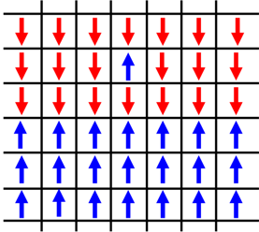
Ising Model

Slide 4
Ising Model
The Ising model, developed by Dr. Ernst Ising, is a simplified representation of magnetic & dielectric material.

Slide 5
Ising Model
The Ising model, developed by Dr. Ernst Ising, is a simplified representation of magnetic & dielectric material.
The model represents these materials as a lattice filled with dipoles or spins.

Slide 6
Ising Model

Slide 7
Ising Model
This model predicts second order transition around the Curie temperature for lattice dimension higher than 1.

Slide 8
Ising Model
This model predicts second order transition around the Curie temperature for lattice dimension higher than 1.
The phase transition is identified by measurables like Magnetization and Energy per site.

Slide 9

Monte-Carlo Algorithm

Slide 10
Algorithm

Slide 11
Algorithm
Pick a spin in the lattice. If the energy of the system decreases (delE<0) then flip the spin and move to the next one.

Slide 12
Algorithm
Pick a spin in the lattice. If the energy of the system decreases (delE<0) then flip the spin and move to the next one.
If the energy of the system increases then flip the spin with a probability exp{-delE/kT}. Where k is the boltzmann constant and T is the ambient temperature.

Slide 13
Algorithm
Pick a spin in the lattice. If the energy of the system decreases (delE<0) then flip the spin and move to the next one.
If the energy of the system increases then flip the spin with a probability exp{-delE/kT}. Where k is the boltzmann constant and T is the ambient temperature.
Repeat this until the system variables (magnetization or energy per site) reach equilibrium.

Slide 14
Hamiltonian

Slide 15
Hamiltonian
H = ∑Ji,j*Si*Sj - h*∑Si

Slide 16
Hamiltonian
H = ∑Ji,j*Si*Sj - h*∑Si
Ji,j : Coupling between jth and ith spins.

Slide 17
Hamiltonian
H = ∑Ji,j*Si*Sj - h*∑Si
Ji,j : Coupling between jth and ith spins.
Si :ith spin, can take value +1(Up-spin) or-1(Down-spin)

Slide 18
Hamiltonian
H = ∑Ji,j*Si*Sj - h*∑Si
Ji,j : Coupling between jth and ith spins.
Si :ith spin, can take value +1(Up-spin) or-1(Down-spin)
h : External magnetic field

Slide 19
Simplifications

Slide 20
Simplifications
Nearest neighbour interaction:

Slide 21
Simplifications
Nearest neighbour interaction:
Each spin only isotropically interacts with only its nearest neighbours.

Slide 22
Simplifications
Nearest neighbour interaction:
Each spin only isotropically interacts with only its nearest neighbours.
The coupling(Ji,j ) between them is taken to be J=±1.

Slide 23
Simplifications
Nearest neighbour interaction:
Each spin only isotropically interacts with only its nearest neighbours.
The coupling(Ji,j ) between them is taken to be J=±1.
Periodic boundary condition:

Slide 24
Simplifications
Nearest neighbour interaction:
Each spin only isotropically interacts with only its nearest neighbours.
The coupling(Ji,j ) between them is taken to be J=±1.
Periodic boundary condition:
We assume that the entire lattice can be repeated in all direction (i.e. the system is periodic).

Slide 25
Simplifications
Zero external field:

Slide 26
Simplifications
Zero external field:
The is no net external magnetic field (i.e h=0).

Slide 27
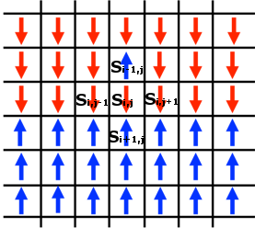
Hamiltonian of Si,j
H i,j= J*Si,j*{Si,j+1 +Si,j-1 + Si+1,j + Si-1,j}

Slide 28
Hamiltonian of Si,j
H i,j= J*Si,j*{Si,j+1 +Si,j-1 + Si+1,j + Si-1,j}
We take J=+1 to model Ferromagnetic material

Slide 29
Simulation

Slide 30
Simulation

Slide 31
Simulation
The code is run on a 30x30 lattice and is evolved at 100 temperatures between the temperatures 1.5-to 3.5-J/k.

Slide 32
Simulation
The code is run on a 30x30 lattice and is evolved at 100 temperatures between the temperatures 1.5-to 3.5-J/k.
The process of flipping spins is performed over 100 iterations to get the lattice to equilibrium, we arrived at this value by trial and error as stated in the previous section.

Slide 33
Simulation
The code is run on a 30x30 lattice and is evolved at 100 temperatures between the temperatures 1.5-to 3.5-J/k.
The process of flipping spins is performed over 100 iterations to get the lattice to equilibrium, we arrived at this value by trial and error as stated in the previous section.
Magnetization and Internal Energy is averaged over 100 iterations of the function Eq().

Slide 34
Results

Slide 35
Ferromagnetic Coupling
(J=+1)

Slide 36
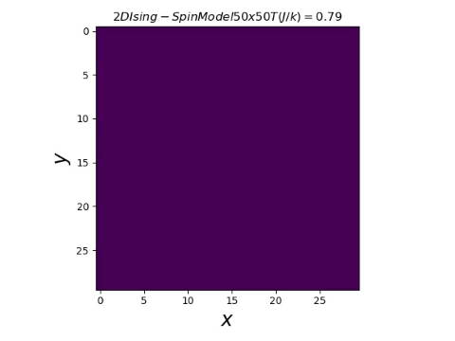

Slide 37
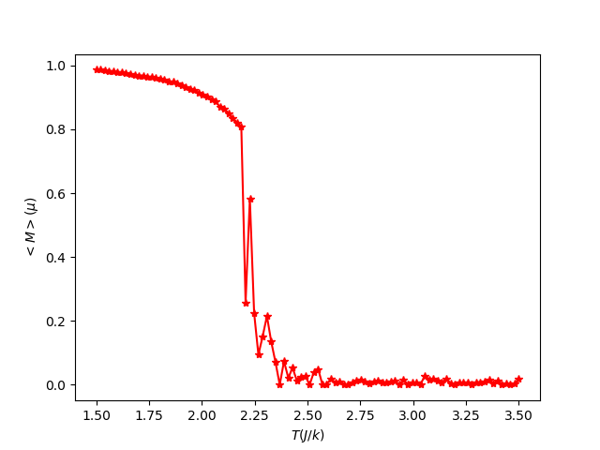
Average Magnetization

Slide 38
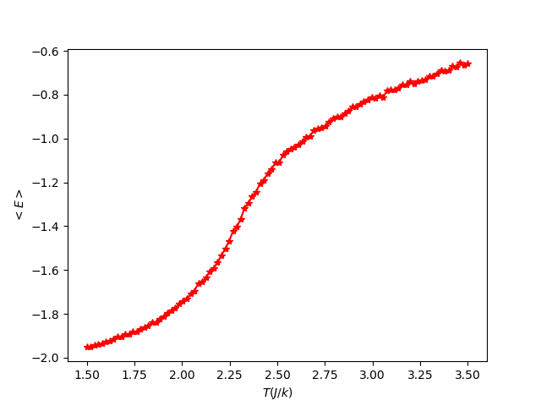
Average Internal Energy

Slide 39
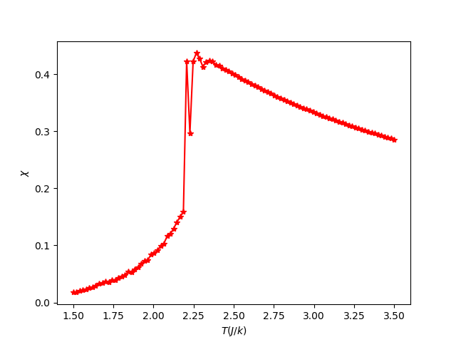
Magnetic Susceptibility

Slide 40
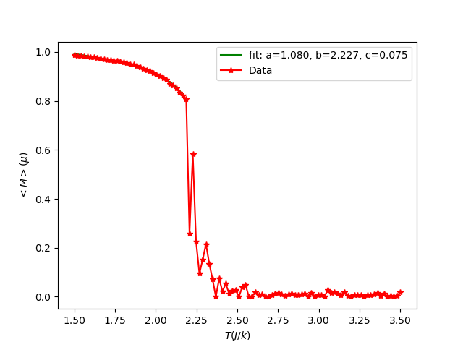
Curie Temperature(T_{c})

Slide 41
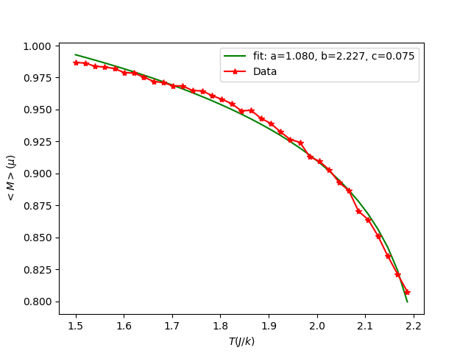
Curie Temperature(T_{c})

Slide 42
Curie Temperature (T_{c})
The equation that is used to fit into the data is :
y=a(1-x/b)^{c}
a=1.080
b=T_{c}= 2.227(J/k_{b})
c=0.075
Comparing to the value obtained analytically:
T_{c}=2.269(J/k_{b})
We have an error of 1.8%

Slide 43

When a magnet is
cooled down

Slide 44
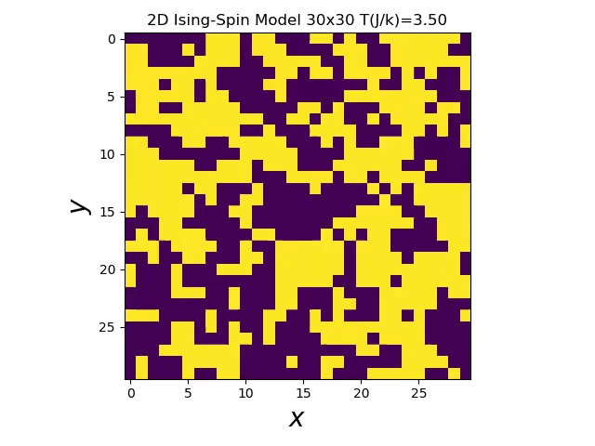

Slide 45
Antiferromagnetic Coupling
(J=-1)

Slide 46
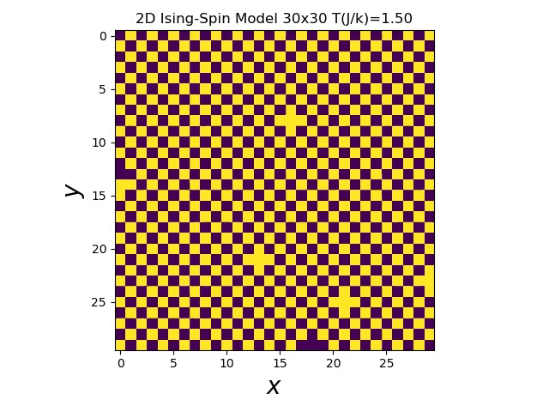

Slide 47
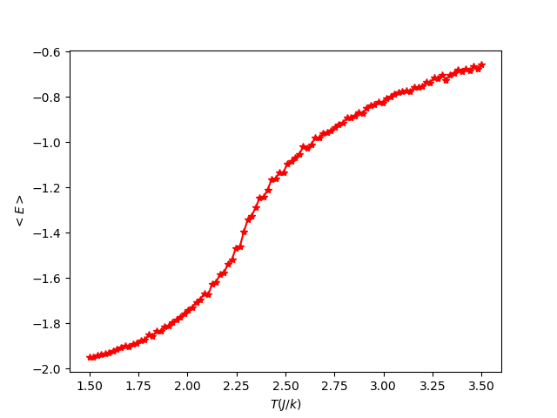
Average Internal Energy

Slide 48
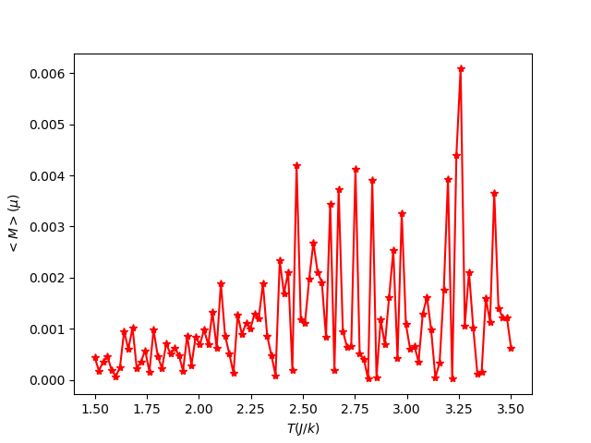
Average Magnetization

Slide 49
Future Prospects
What happens if we extend the interaction to more neighbours(r⁻³ coupling)?
What kind of structures would we see if we used Heisenberg spins(Vortices pairs)?
What happens if we turn on an external magnetic field (hysteresis)?
What happens to Tc as we increase the lattice size/ change its shape?
How do free and periodic boundary conditions affect the physics of the system?
Can we observe spontaneous symmetry breaking in our simulation?
What happens to the correlation functions as we increase temperature?
What happens if we extend the interaction to more neighbours?

Slide 50
Thank You

